Slide 1
CLIMATE CHANGE AND GLOBAL BIODIVERSITY
GROUP 17, TOPIC 10.

Slide 2
OUTLINE
Climate change
Causes
Why this fast rate?
Evidence of climate change
Effects of biodiversity
Solutions
Conclusion

Slide 3
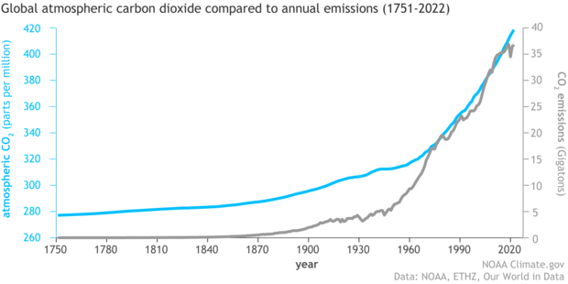
CLIMATE CHANGE
Climate change refers to long-term shifts in temperature and weather patterns.
An increasing level of CO2 emissions and accumulation since the industrial revolution in the 1950’s.
Humans are the main drivers of climate change.
fig. 1

Slide 4
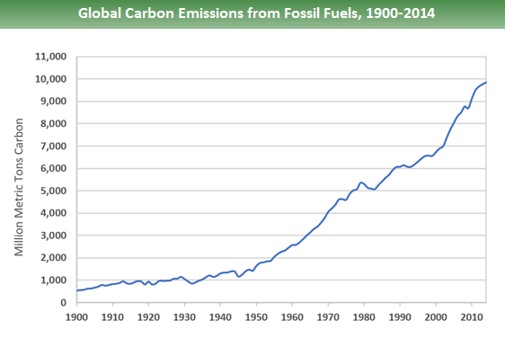
CAUSES
Burning of fossil fuels : Buried carbons from dead organisms are burnt and adds excess carbon.
Deforestation
Industrial processes
Increasing human population
fig. 2

Slide 5
WHY THIS FAST RATE ?
Positive feedback loop :
Water vapour: Hotter oceans causes more evaporation of water vapour. Water vapour is also a green house gas which leads to further global warming.
Reduced ice cover: : Melting of ice caps reduce its reflective surface, leading to increased adsorption of solar radiation and further warming.
Permafrost : Large parts of Greenland, Siberia, Alaska and Canada are covered with permafrost. Permafrost releases a lot of green house gases when it thaws.

Slide 6
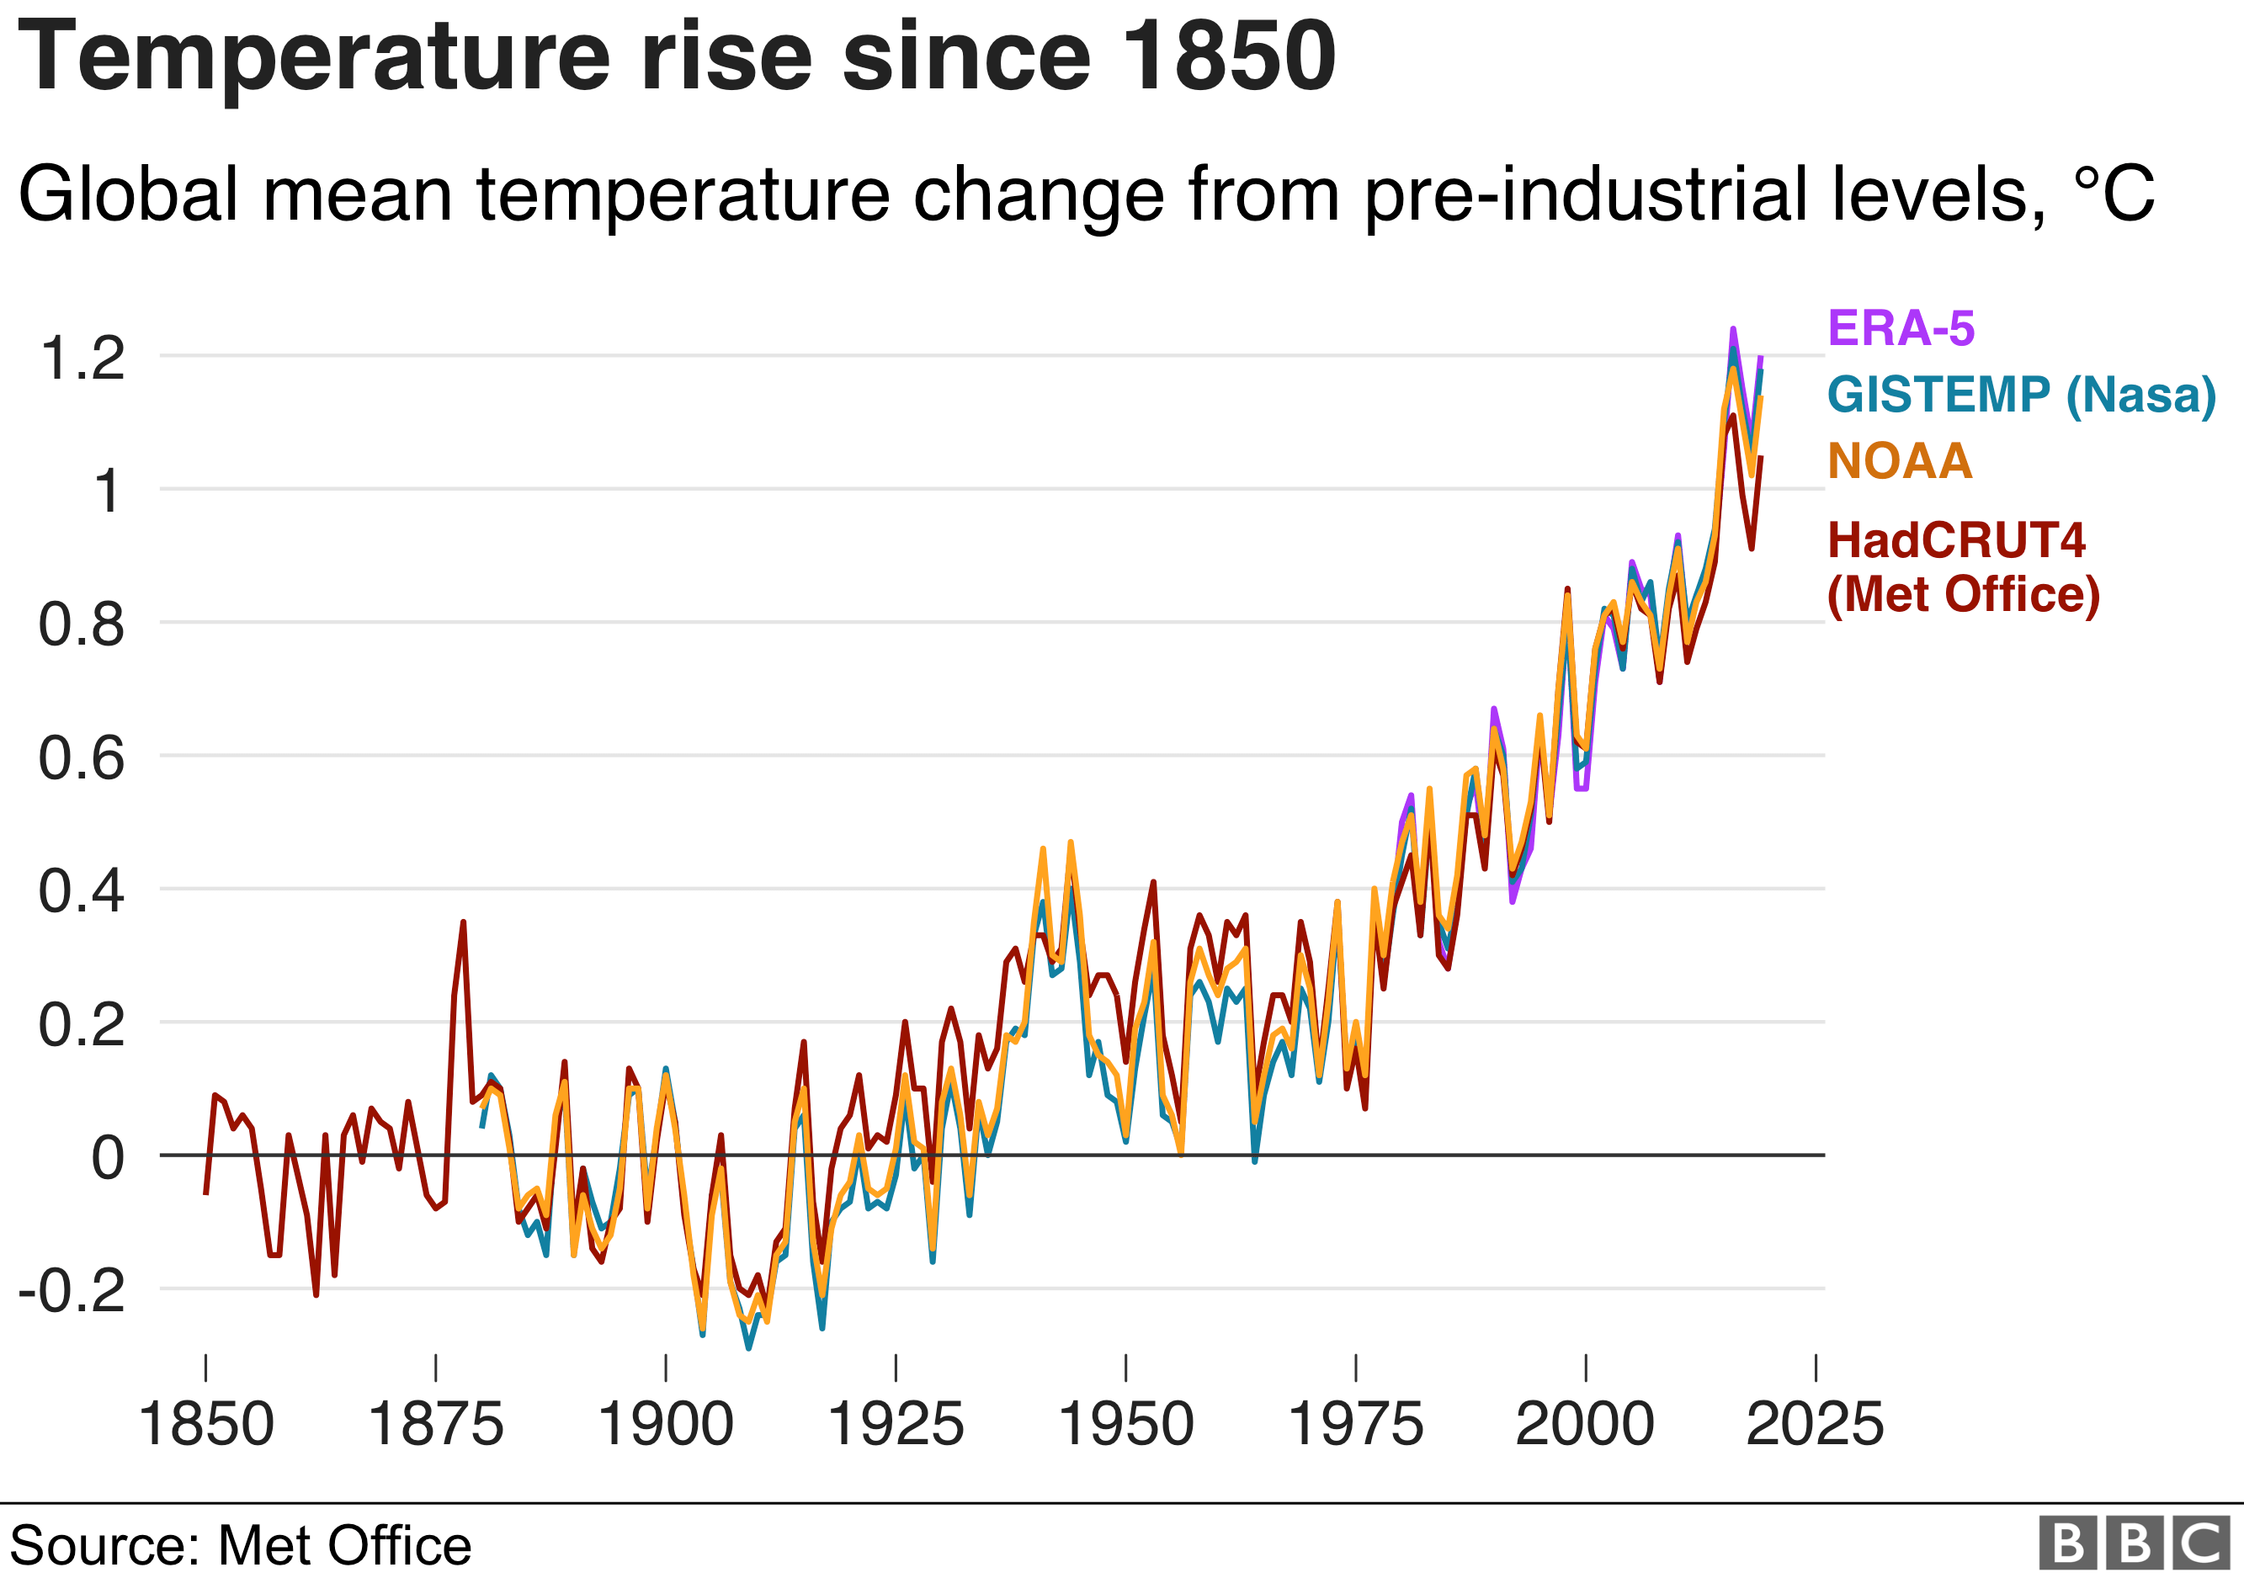
EVIDENCE OF CLIMATE CHANGE
Rising temperature levels
Changing precipitation patterns
Ocean acidification
Rising sea levels
fig. 3

Slide 7
EFFECTS ON BIODIVERSITY
Range shift and distribution : Shift in species geographic location. Eg. Artic fox
Biodiversity loss/ Extinction : Fluctuations in temperature and rainfall that lead to loss of species.
Impact on food security/ Hunger : Disruption of agricultural systems.

Slide 8
EFFECTS ON BIODIVERSITY cont’d
Decline in ecosystem services : Services provided by ecosystems such as pollination, nutrient cycling, water purification.
Carbon-dioxide adsorption by oceans disrupts coral reefs health which support diverse marine life.
Natural disasters such as flooding , drought.

Slide 9
THE RESILEINCE OF BIODIVERSITY TO CLIMATE CHANGE
Healthy ecosystems buffer climate impacts. Eg. They can absorb large amounts of water, and reduce the risk of flooding.
Species adopt behavioural changes such as migrating in warmer times of the year.
Tails, feathers and ears of some species are providing different levels of heat exchange.

Slide 10
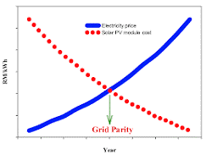
SOLUTIONS
  Mitigation: Stop burning fossil fuel to reduce greenhouse gas
  Transitioning to renewable energy sources such as solar energy and thermal energy promoting energy efficiency.
  Save energy.
  fig. 4

Slide 11
SOLUTIONS
  Conservation: Protect and restore habitats to ensure the survival of vulnerable species.
  Promote sustainable land use practices : Eg. Agroforestry and sustainable agriculture
  Education and awareness

Slide 12
CONCLUSION
Conserving and restoring natural spaces and the biodiversity they contain, is essential for limiting emissions and adapting to climate impacts.
Let's work together to combat climate change and protect the incredible biodiversity that sustains our planet

Slide 13
REFERENCES
UNICEF. The Climate Crisis is a Child Rights Crisis. New York (2021).
The World Health Organization. Quantitative risk assessment of the effects of climate change on selected causes of death, 2030s and 2050s. Geneva: WHO 2014.
Williams PC, Bartlett AW, Howard-Jones A, McMullan B, Khatami A, Britton PN, et al. Impact of climate change and biodiversity collapse on the global emergence and spread of infectious diseases. J Paediatr Child Health. (2021) 57:1811–8. doi: 10.1111/jpc.15681.

Slide 14
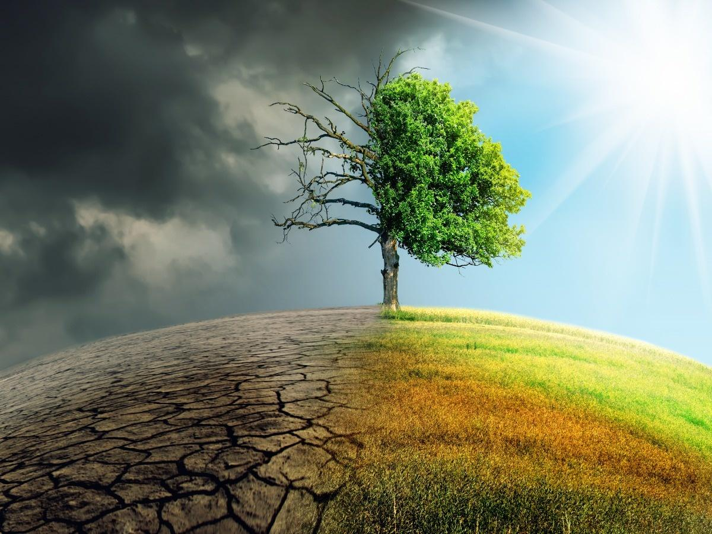

THANK YOU

